Slide 1


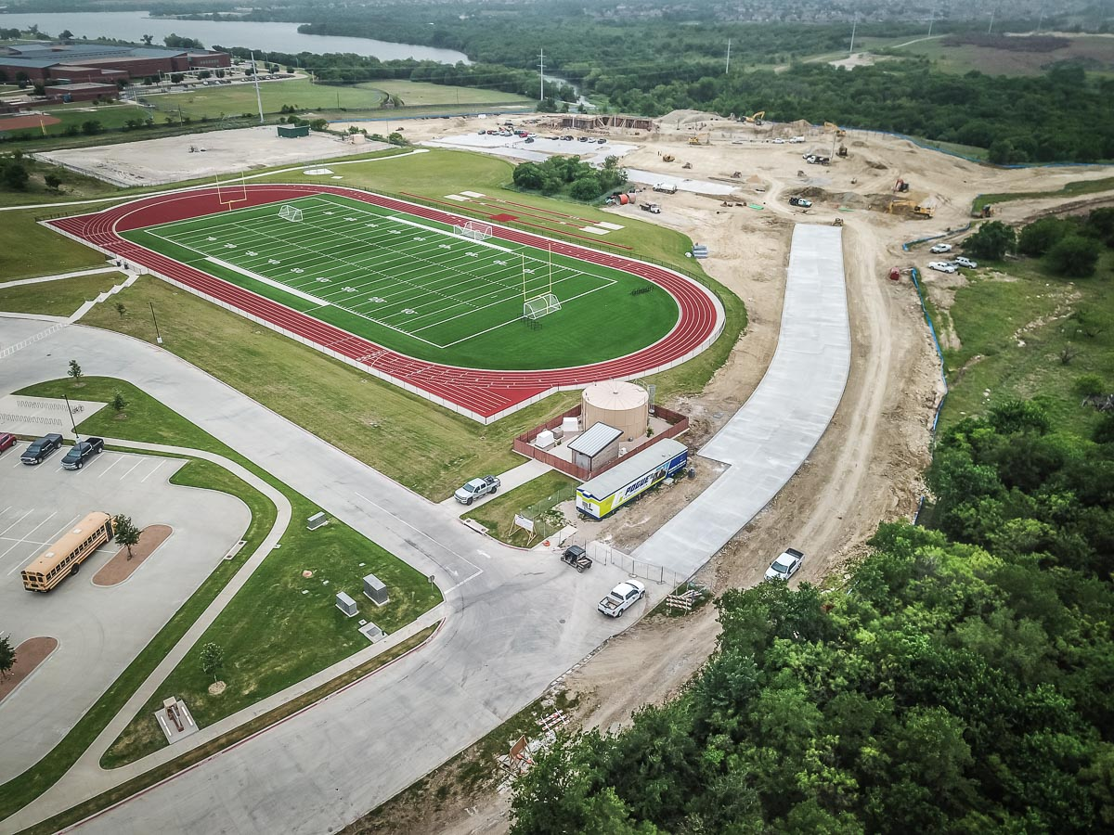
NEW ADMINISTRATION BUILDING
The main extension of Mustang Rock connecting to the parking lot has been poured.

Slide 2
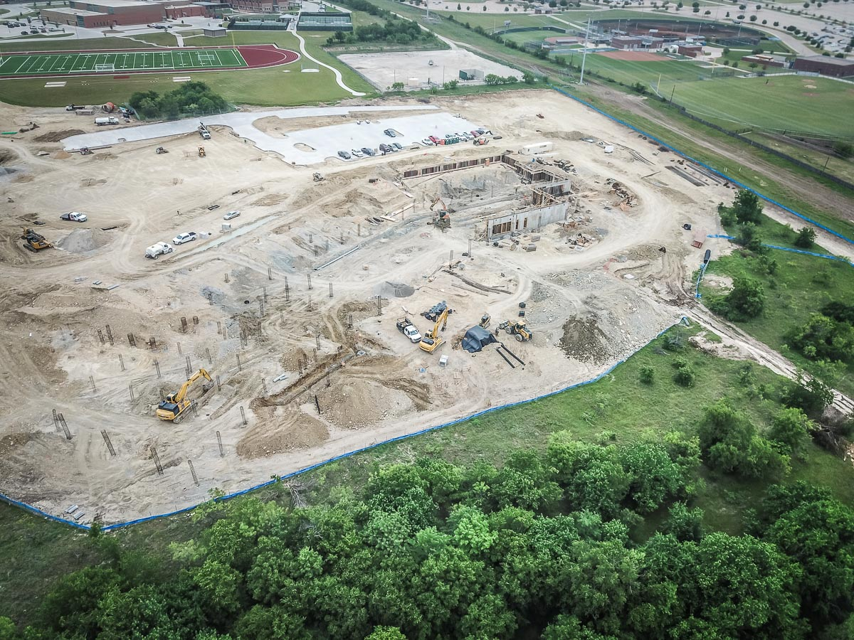
The building location is outlined by the iron piers. The Board room is located in the bottom left and finance is in the top right of the photo.

Slide 3
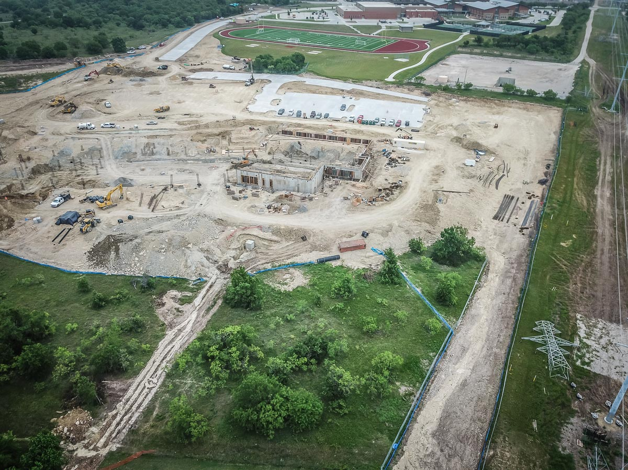
The storm water connection has been completed on the western side of the site.

Slide 4
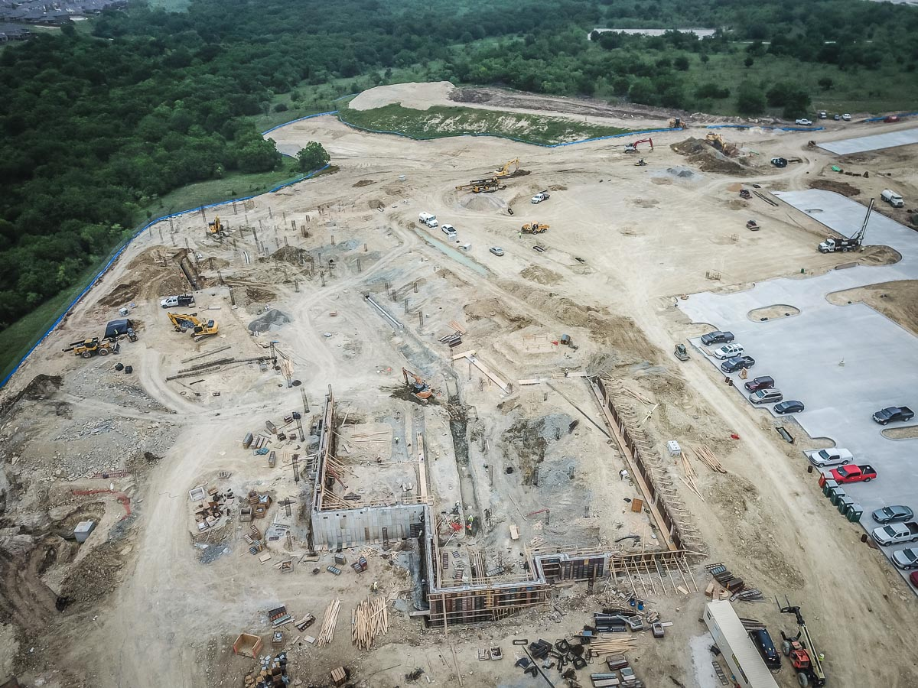
The building wall concrete structure in the superintendent, operations, and finance office areas has been completed. Excavation of the grade beams is progressing.

Slide 5
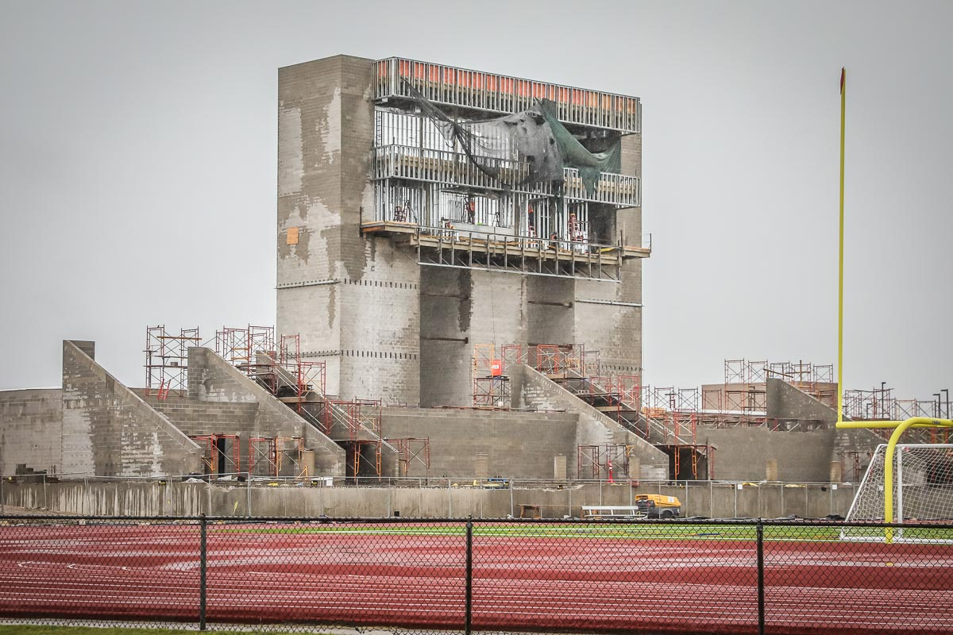
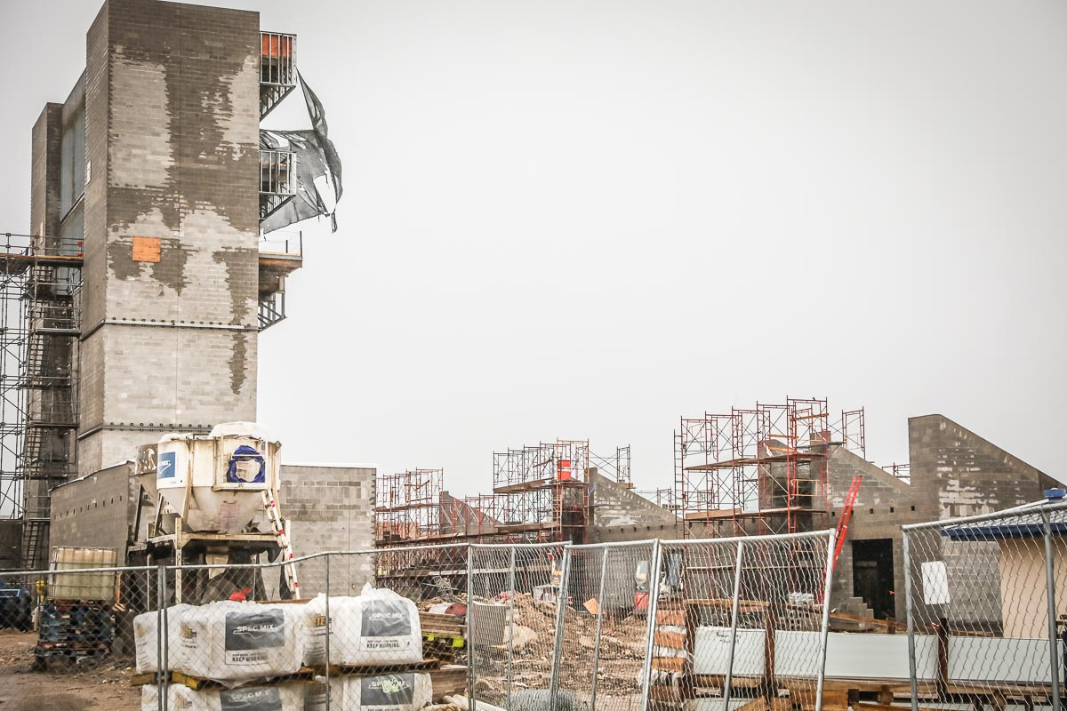
BOSWELL HS
CMU storage buildings and restrooms are in progress. The roof on the pressbox has been completed.

Slide 6
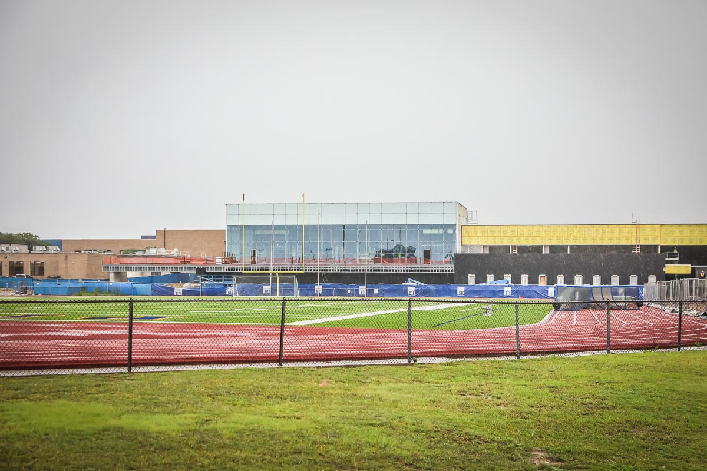
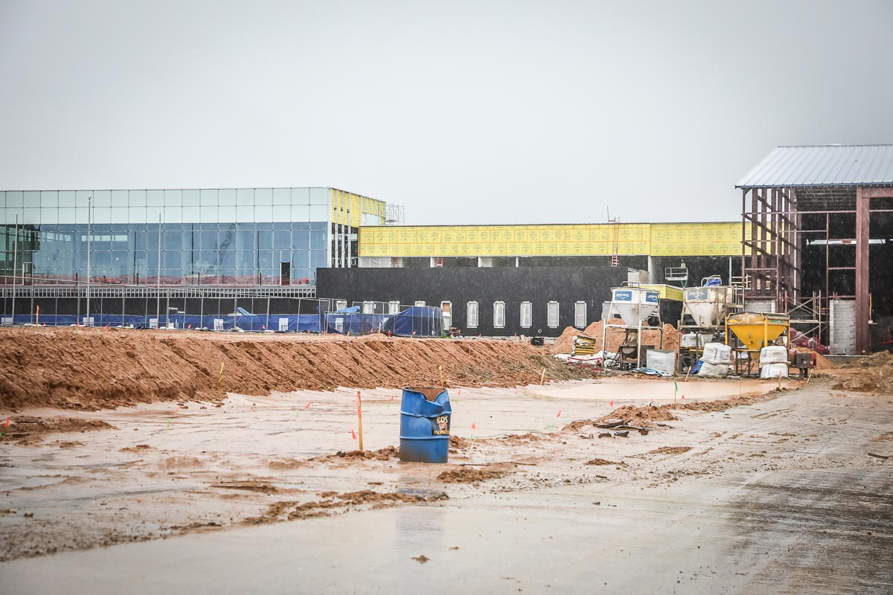
Pier drilling has begun on the visitor bleachers and is expected to be completed on August 30, 2021.
The weight room glass wall has been installed. Moisture conditioning of the remaining structure has been completed.

Slide 7
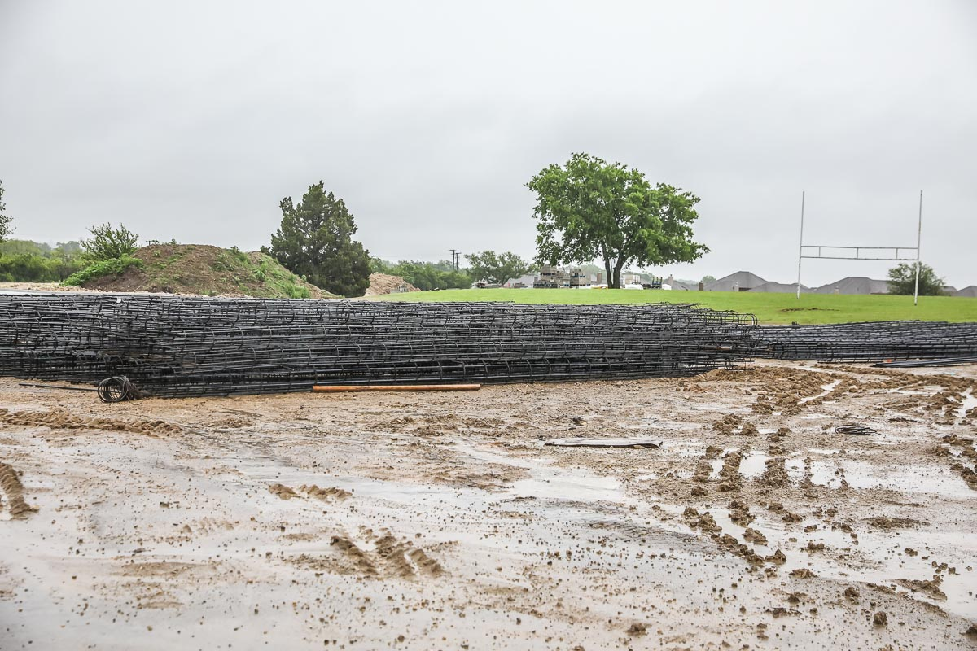
This photo shows the pier rebar for the visitor bleachers has been tied together.

Slide 8
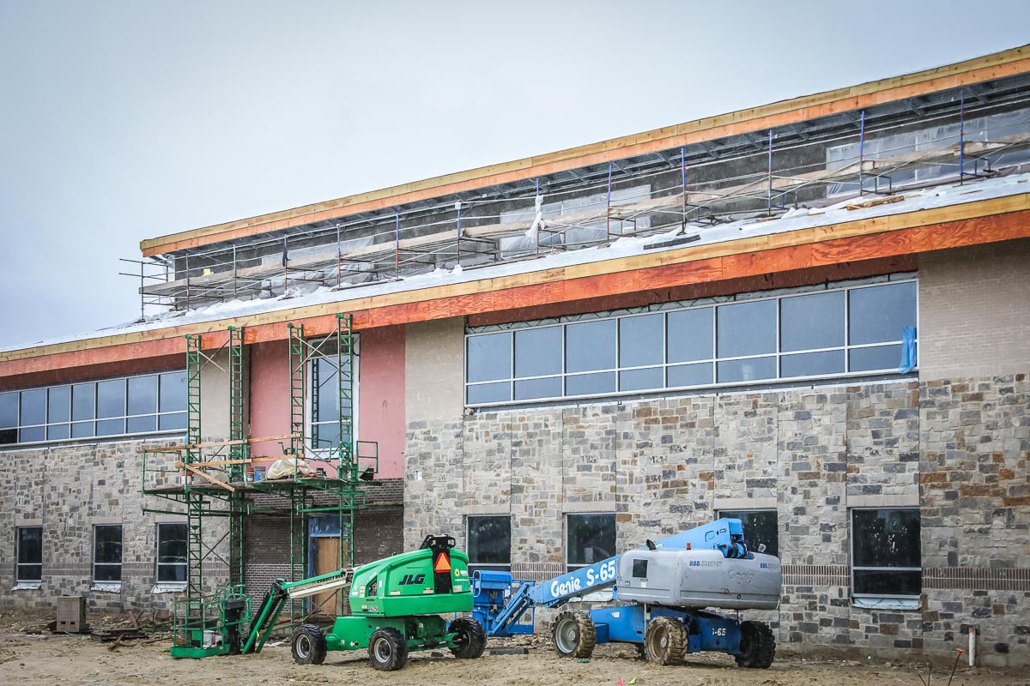
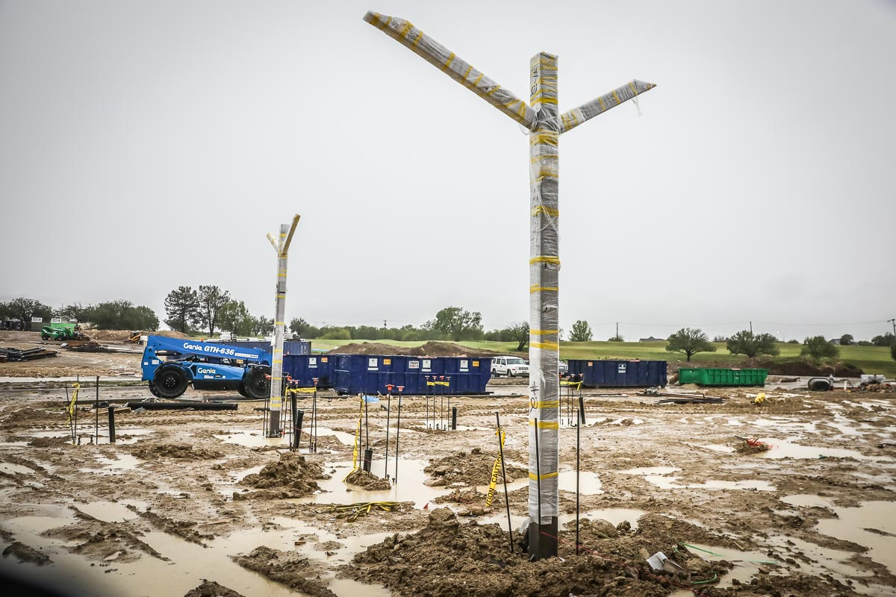
LAKE COUNTRY ES
Installation of the columns for the bus canopy has begun. Plaster on the top floor of the exterior of the building is near completion.

Slide 9
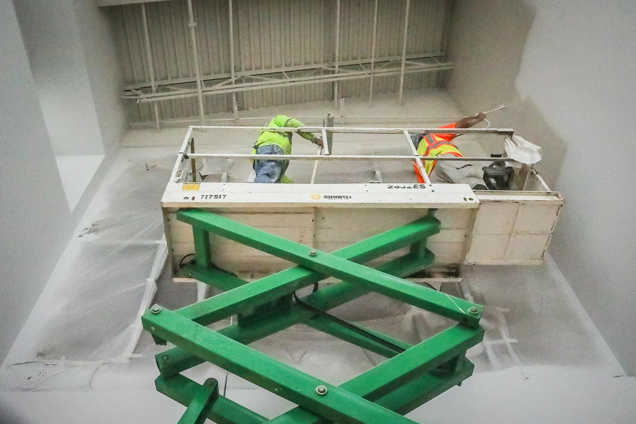
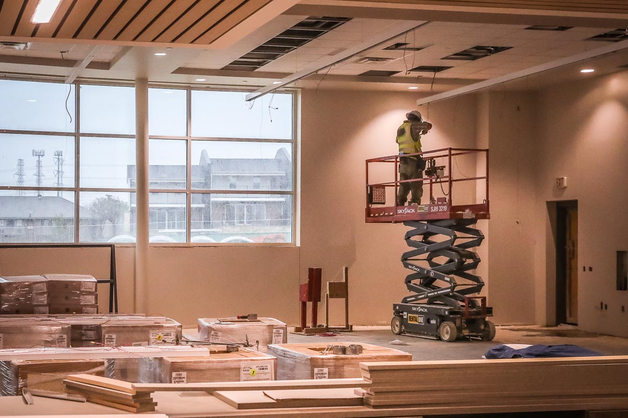
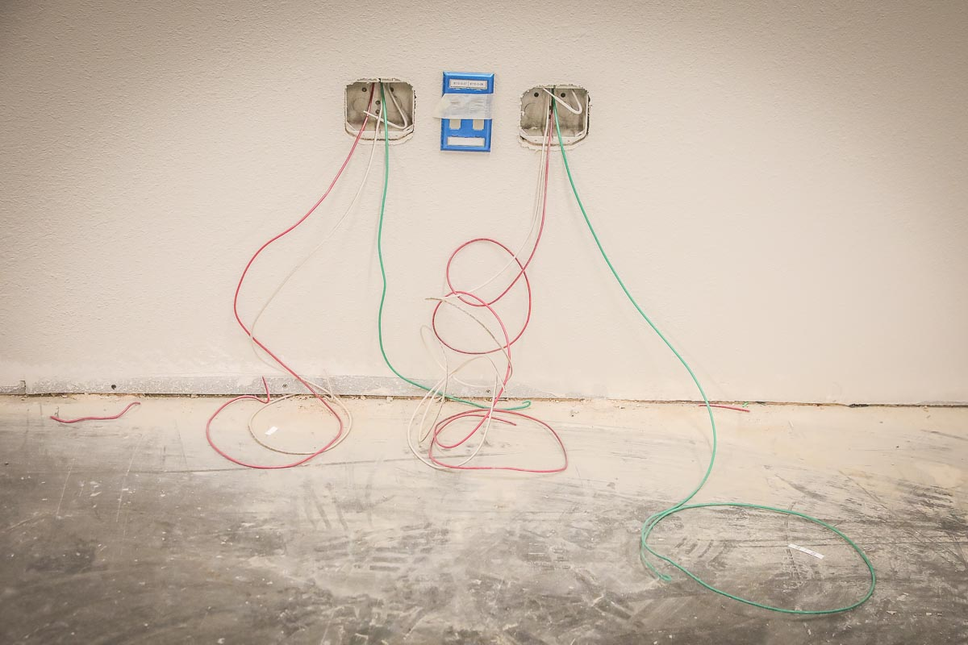
Main foyer is receiving final coat of paint.
Finish lighting has been installed in the library.

Slide 10
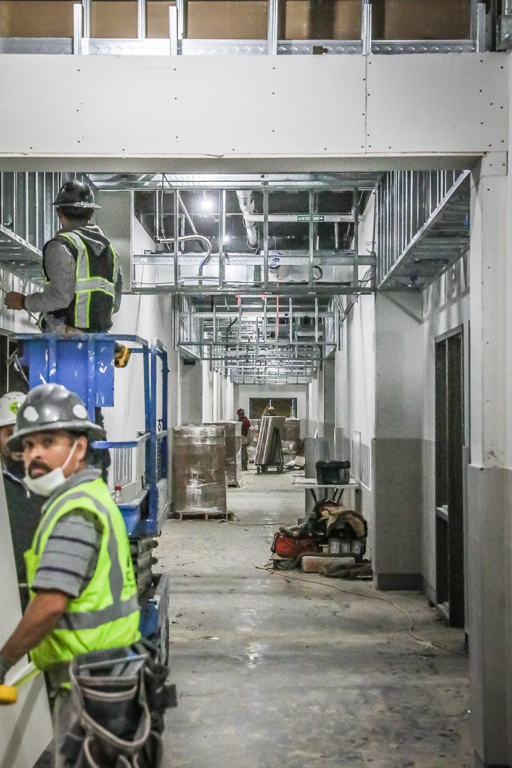
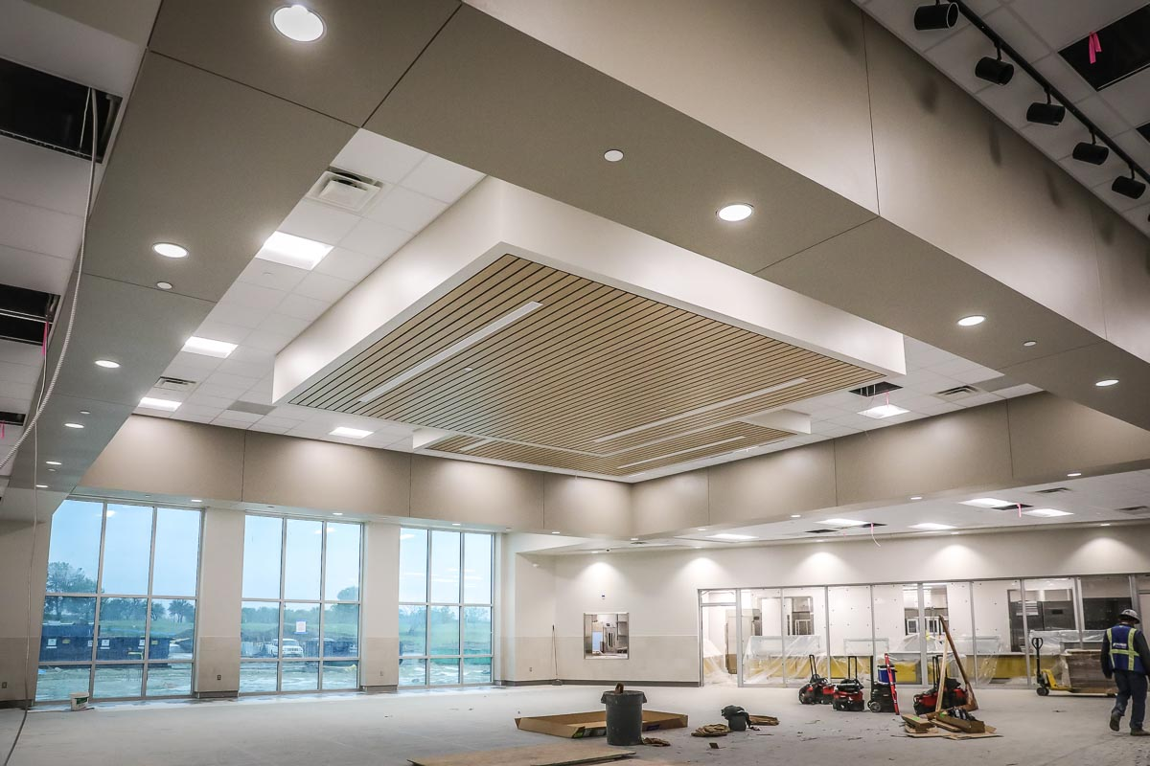
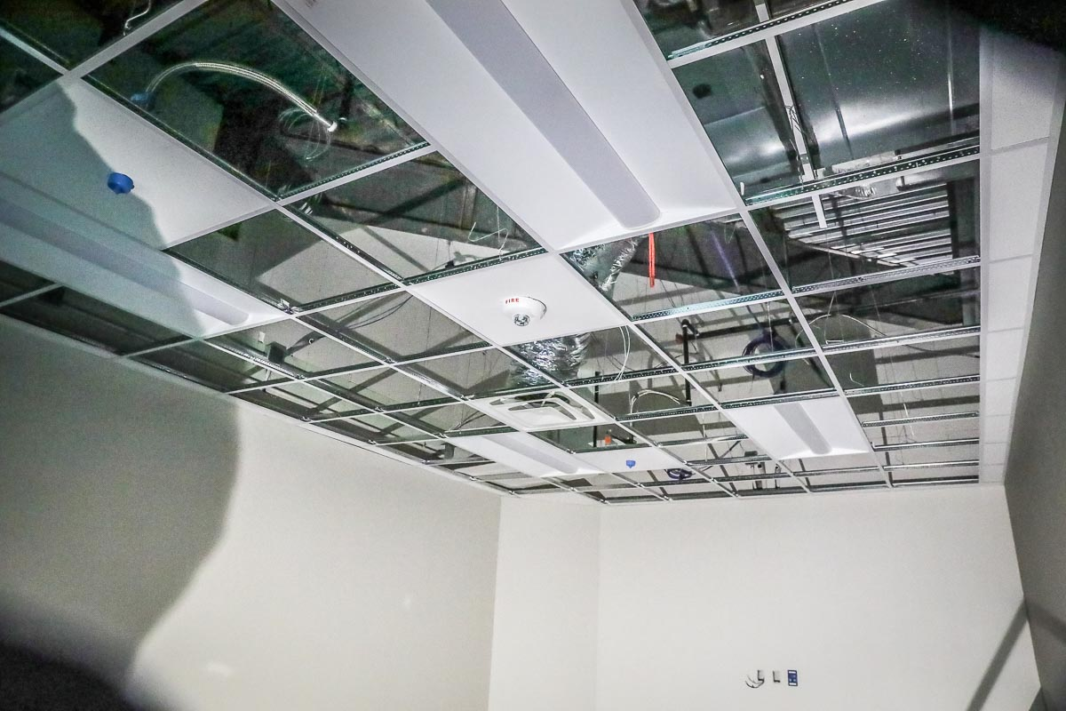
Cafeteria lighting and ceiling have been completed. Ceiling grid in area 1 is in progress.
Area 2 hallway sheetrock has been installed.

Slide 11
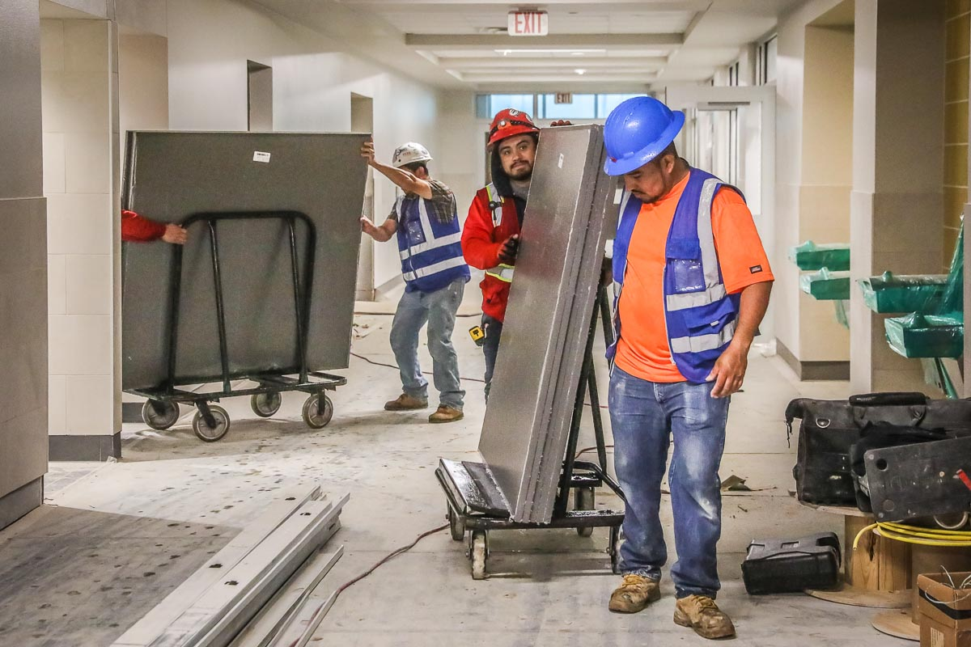
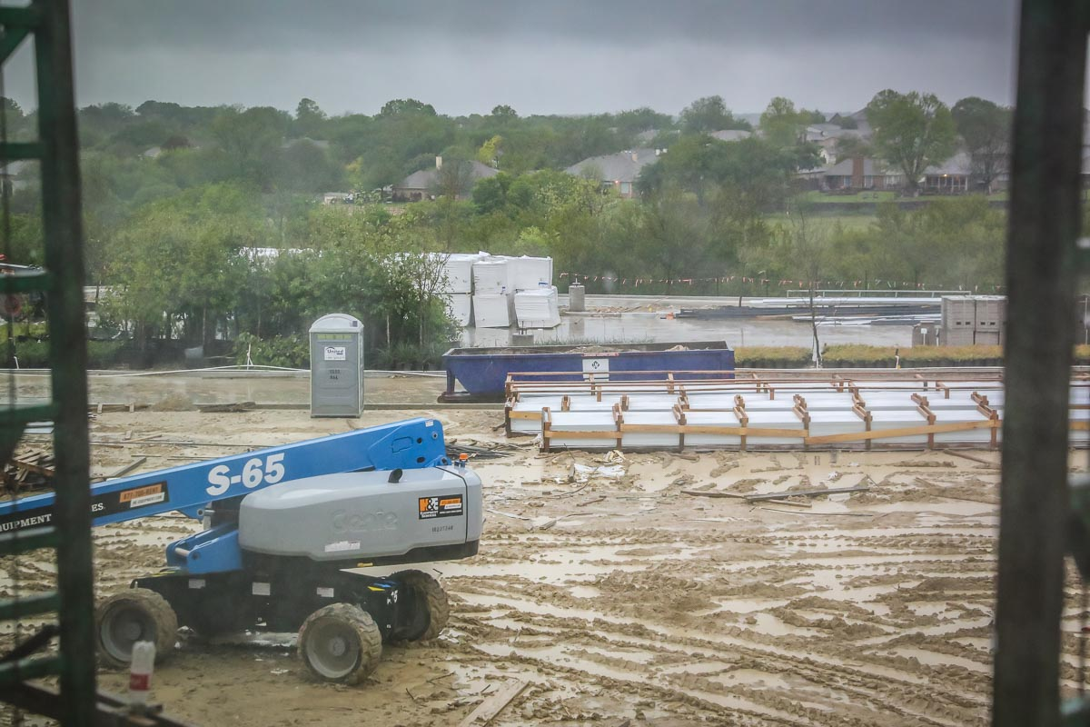
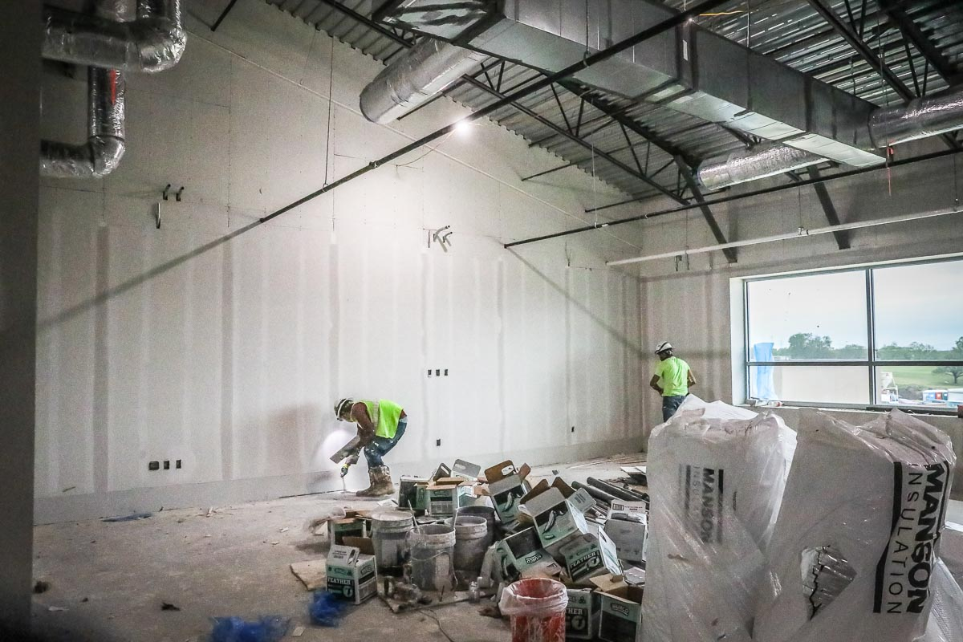
Bathroom partitions have arrived on site and are being installed. Roof panels have arrived and are waiting for installation. Area 6 classrooms are sheetrocked with tape and bedding in progress.

Slide 12
OTHER PROJECTS
Baseball/Softball Turf Projects at Chisholm Trail HS and Saginaw HS -
Hellas has mobilized on site and has begun excavation and moisture and conditioning. Chisholm Trail HS construction entrances are installed at both the baseball and softball fields. Earthwork has begun at the baseball field. Saginaw HS baseball and softball fields construction entrance installations are in progress.

